Slide 1

MSc Data Science AUEB Data Visualization and Communication Professors: Dimitris Karlis, Nikos Platis Giagkos Stylianos | f3352410
“Greece in the Global Classroom”
Insights from PISA 2018
An Evidence-Based Overview of Student Performance, Investment and Equity

Slide 2
Introduction
Greece in the Global Classroom: Insights from PISA 2018

Slide 3

Introduction
Why PISA Matters
Global benchmark as Academic and Socioeconomic Status of Students in Reading, Math & Science
- Conducted by the OECD in 70+ countries every 3 years
- Enables cross-country comparisons of student outcomes
- Informs education policy with evidence-based insights
What this study examines
- Greece’s performance in context of global, gender, equity, and investment dimensions
Greece in the Global Classroom: Insights from PISA 2018

Slide 4
R - Plots
Greece in the Global Classroom: Insights from PISA 2018

Slide 5
Academic
Insights
Greece in the Global Classroom: Insights from PISA 2018

Slide 6
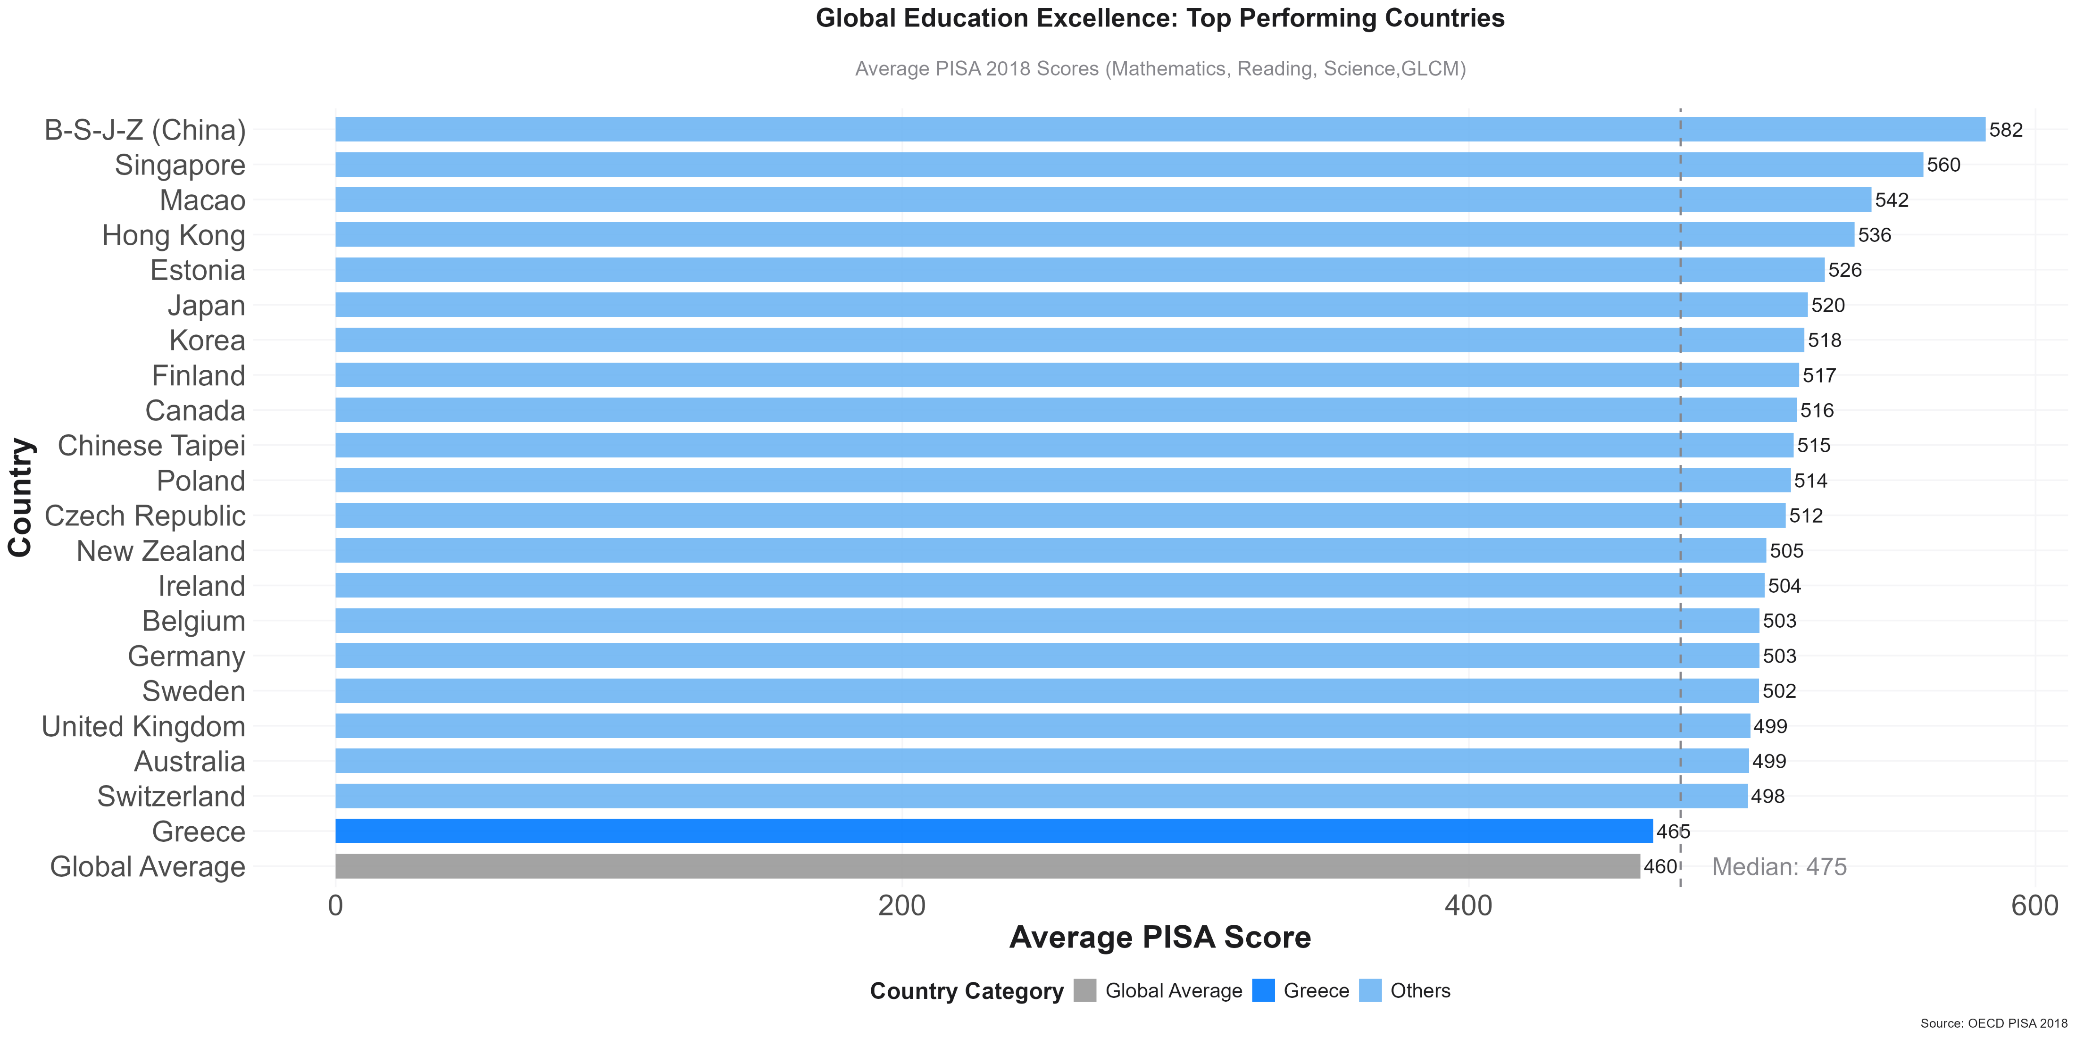
Global Education Excellence: Top Performing Countries
Global Education Excellence: PISA 2018 Highlights
Top Performers:
- East Asian economies (China, Singapore, Macao) lead.
Strong Showing:
- Many European nations excel.
Greece’s ranking:
- Greece’s score (465), slightly above the global average of (460) below the median (475)
Overall:
- Wide range in global education performance.
Sources
OECD PISA 2018, World Bank Education Data
Greece in the Global Classroom: Insights from PISA 2018

Slide 7
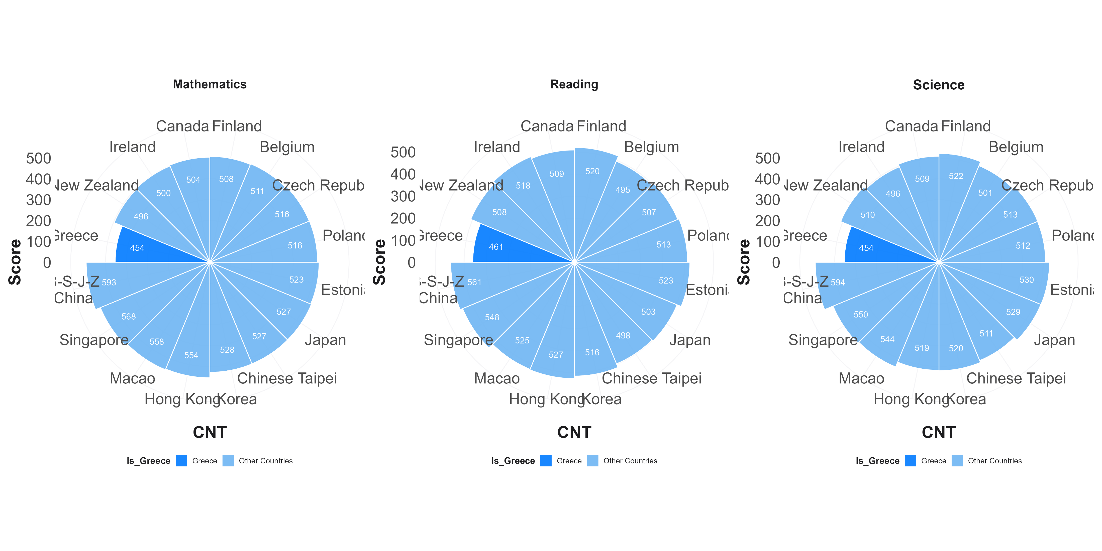
Subject Excellence Across Top Performing Nations
Subject-Wise PISA 2018 Performance
Mathematics
- China leads (593), followed by Singapore and Macao.
- Greece: 454 — well below OECD average.
Reading
- Top scorers: China (561), Singapore, Hong Kong.
- Greece: 461 — modestly below global average.
Science
- China again tops (594), followed by Singapore and Estonia.
- Greece: 454 — among the lowest in this comparison.
Insights
- East Asian countries dominate across all subjects.
- Europe performs well, especially in reading and science.
- Greece trails significantly in all subjects, highlighting need for systemic educational improvements.
Sources
OECD PISA 2018, World Bank Education Data
Greece in the Global Classroom: Insights from PISA 2018

Slide 8
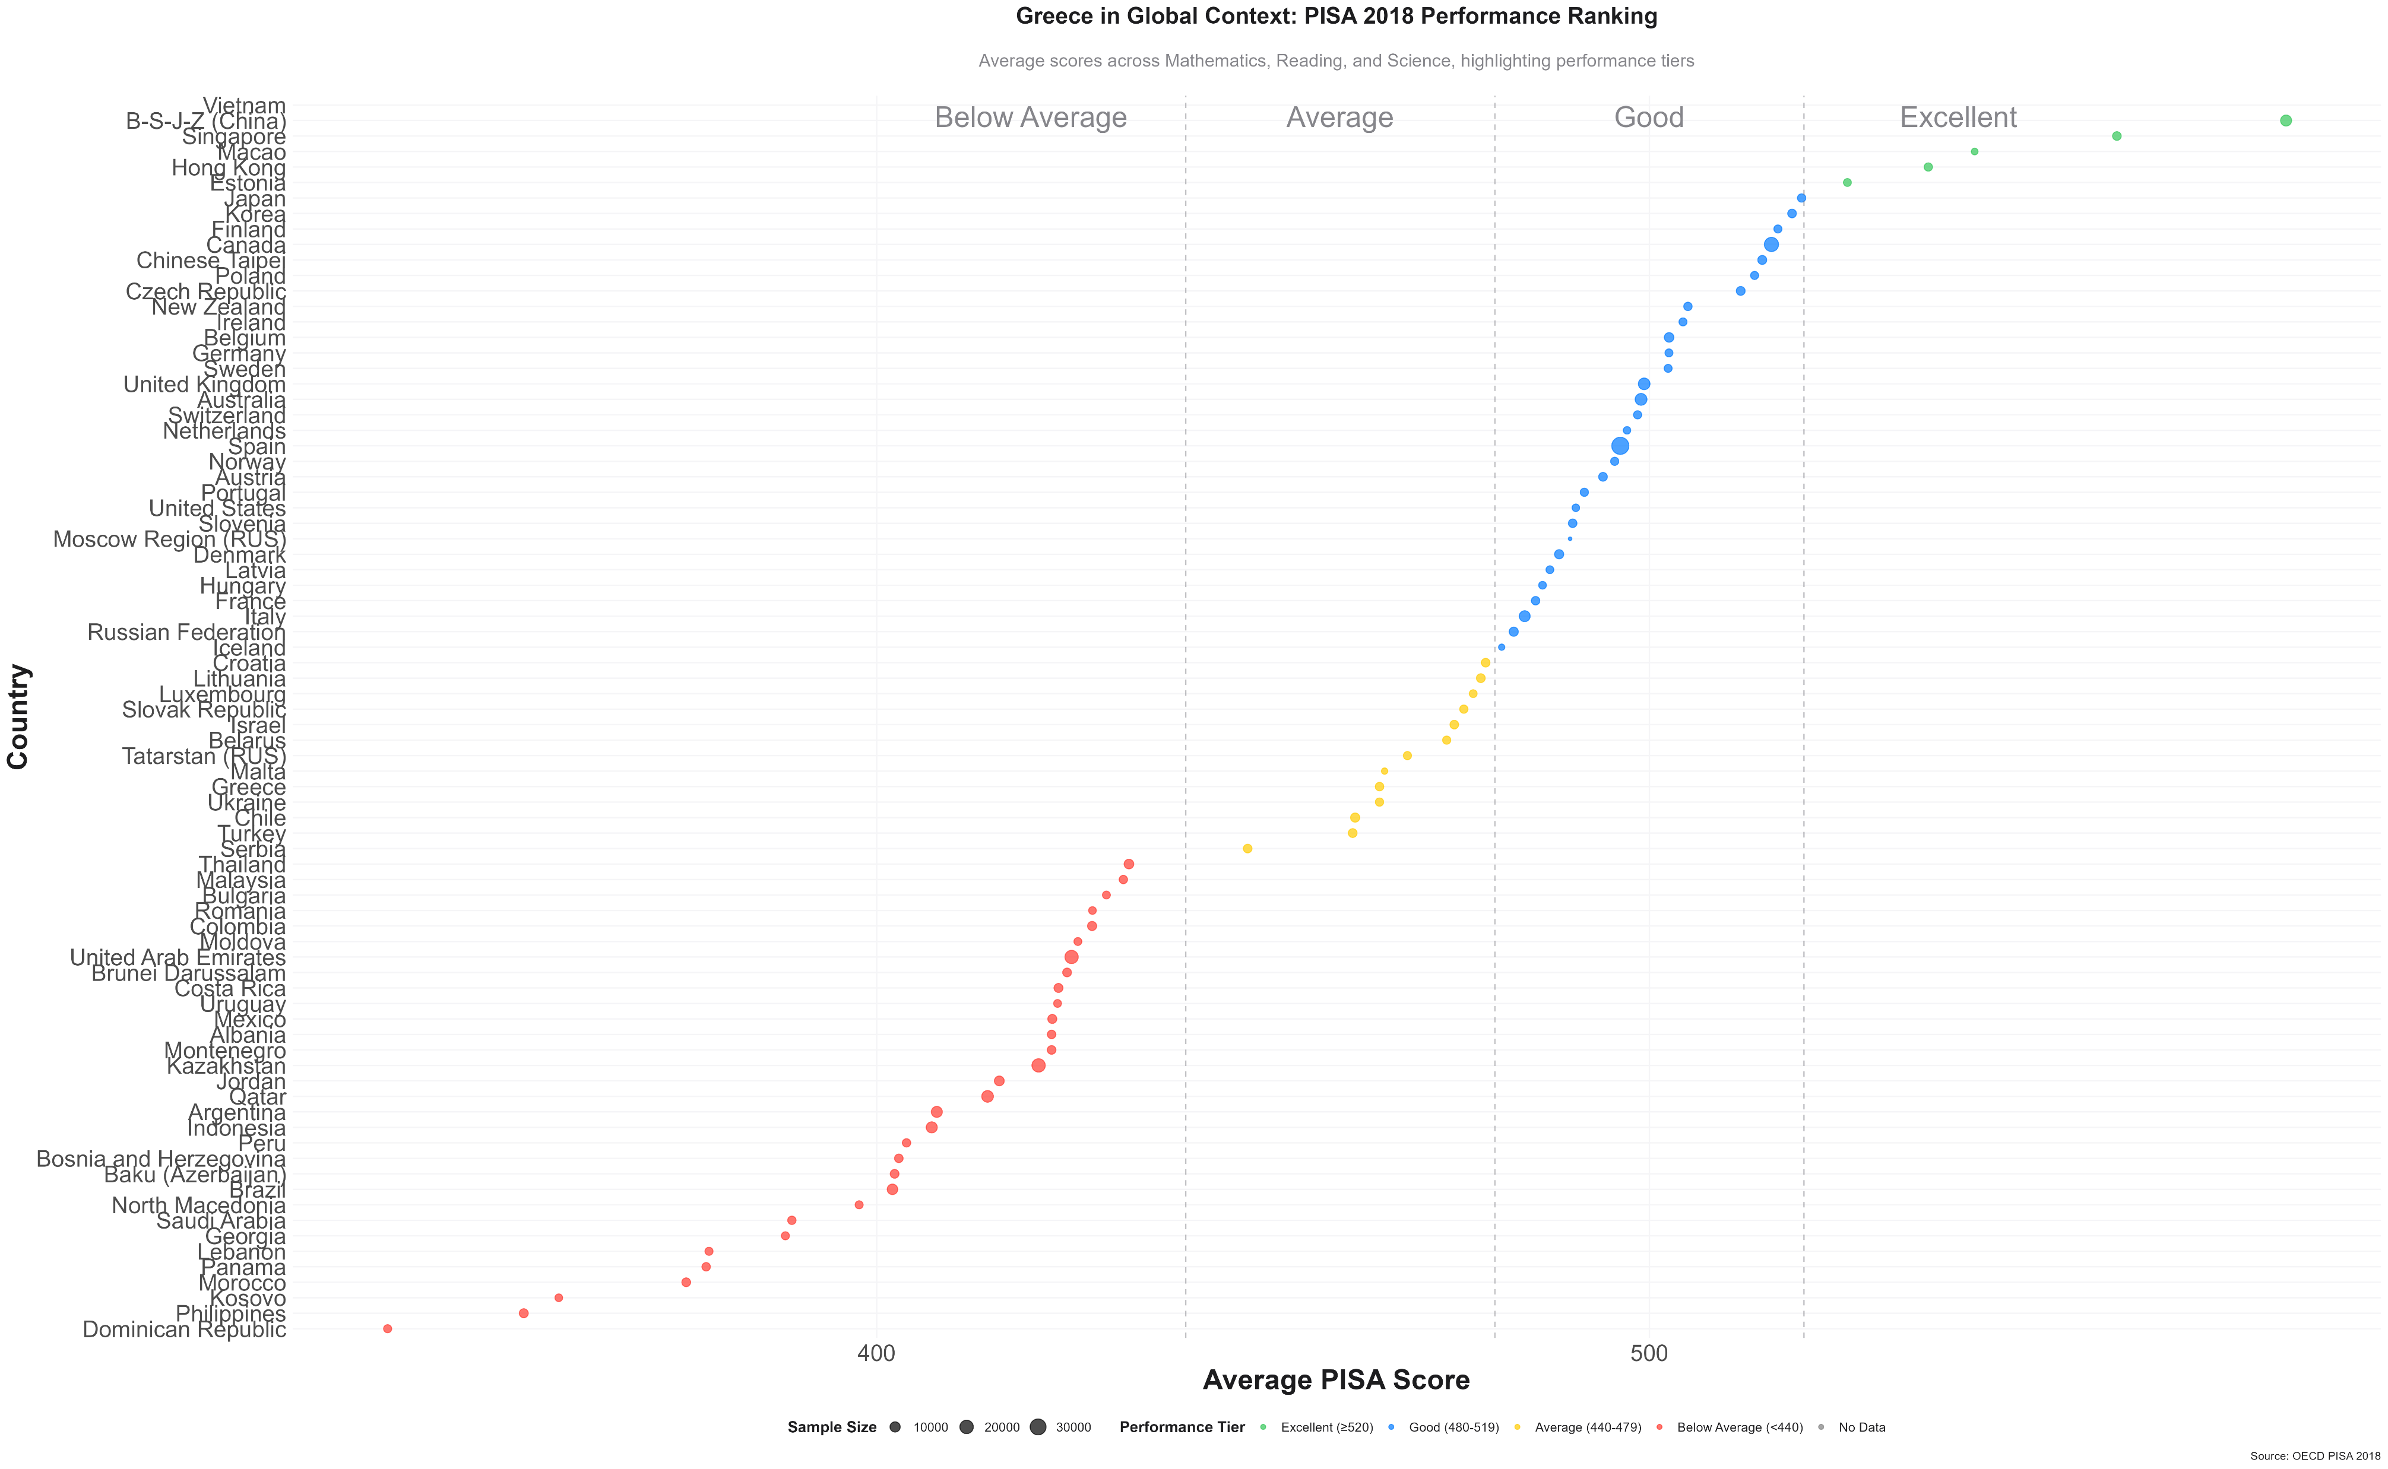
Greece in Global Context: PISA Performance Ranking
Greece in Global Context: PISA 2018
Ranking Overview
Countries are ranked by average scores across math, reading, and science.
Performance tiers are color-coded:
🟢Excellent (≥520)
🔵Good (480–519)
🟡Average (440–479)
🔴Below Average (<440)
Greece
- Score: 465, placing in the “Average” tier.
- Positioned just above the global average, but below most OECD peers
Insights
- East Asian countries dominate across all subjects.
- Europe performs well, especially in reading and science.
- Greece trails significantly in all subjects, highlighting need for systemic educational improvements.
Sources
OECD PISA 2018, World Bank Education Data
Greece in the Global Classroom: Insights from PISA 2018

Slide 9
Demographic Insights
Greece in the Global Classroom: Insights from PISA 2018

Slide 10
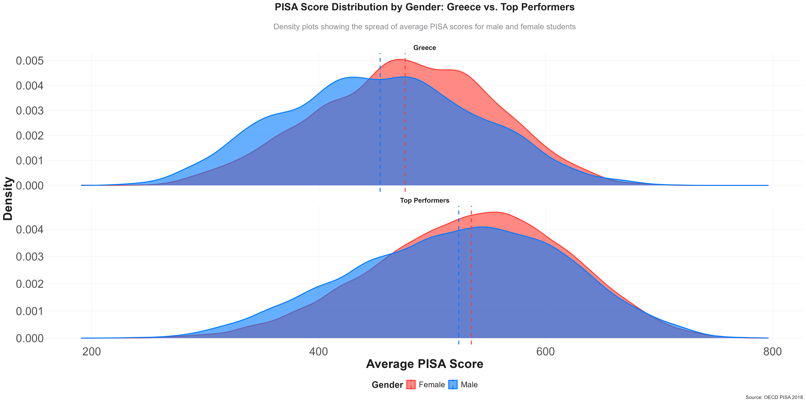
Gender Performance in Greece
Gender-Based Score Distribution
Top Performers (bottom plot):
Females slightly outperform males. Scores are tightly clustered (550–580), indicating consistency.
Well above the OECD average.
Greece (top plot):
Females lead slightly.
Broader score spread shows more variability.
Average: ~465 — above global average (460), below OECD median (475).
Insights
Top performers: high, consistent results across genders.
Greece: moderate scores, wider spread implies equity/quality gaps
Gender gap is small but favors females in both groups.
Sources
OECD PISA 2018, World Bank Education Data
Greece in the Global Classroom: Insights from PISA 2018

Slide 11
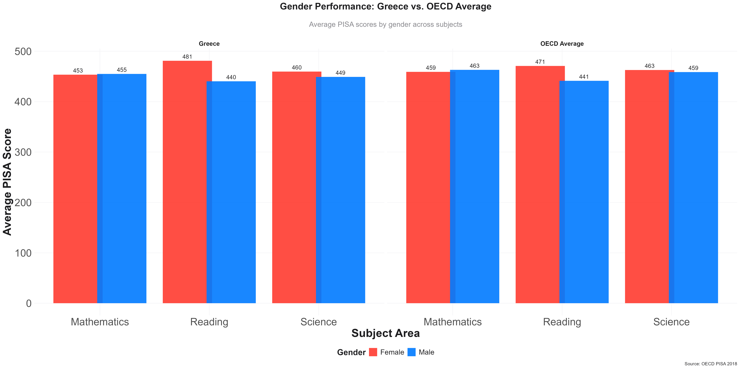
Gender Performance Gaps Across Countries
Gender Comparison Across Subjects
Greece:
Girls outperform boys in Reading and Science.
Math scores are nearly equal (Girls: 453, Boys: 455).
Biggest gap in Reading: +41 for girls.
OECD Average:
Similar trends: Girls lead in Reading (+30) and Science (+22).Boys slightly ahead in Math.
Insights
Gender gaps in Greece reflect OECD patterns, but Reading gap is larger.
Sources
OECD PISA 2018, World Bank Education Data
Greece in the Global Classroom: Insights from PISA 2018

Slide 12
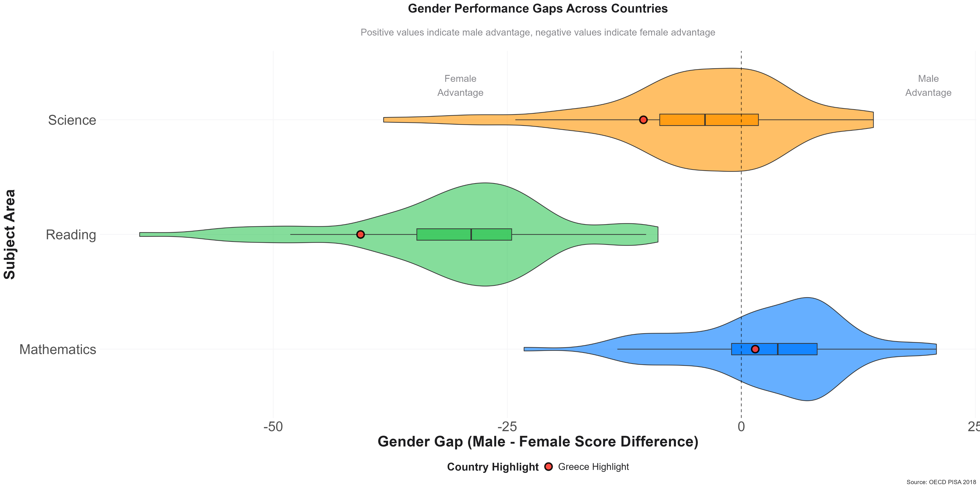
Gender Performance Gaps Across Countries
Gender Gaps in PISA 2018: Global Overview
Science
- Most countries show a male advantage.
Greece is near the global median — small gap.
Reading
Female advantage is widespread and significant.
Greece aligns with this trend — strong female lead.
Mathematics
- Slight male advantage overall.
- Greece again near the middle, with a small gender gap.
Insights
Reading shows the largest and most consistent gender gap, favoring females.
Greece’s gender gaps are moderate and closely match international patterns.
Sources
OECD PISA 2018, World Bank Education Data
Greece in the Global Classroom: Insights from PISA 2018

Slide 13
Socioeconomic Insights
Greece in the Global Classroom: Insights from PISA 2018

Slide 14
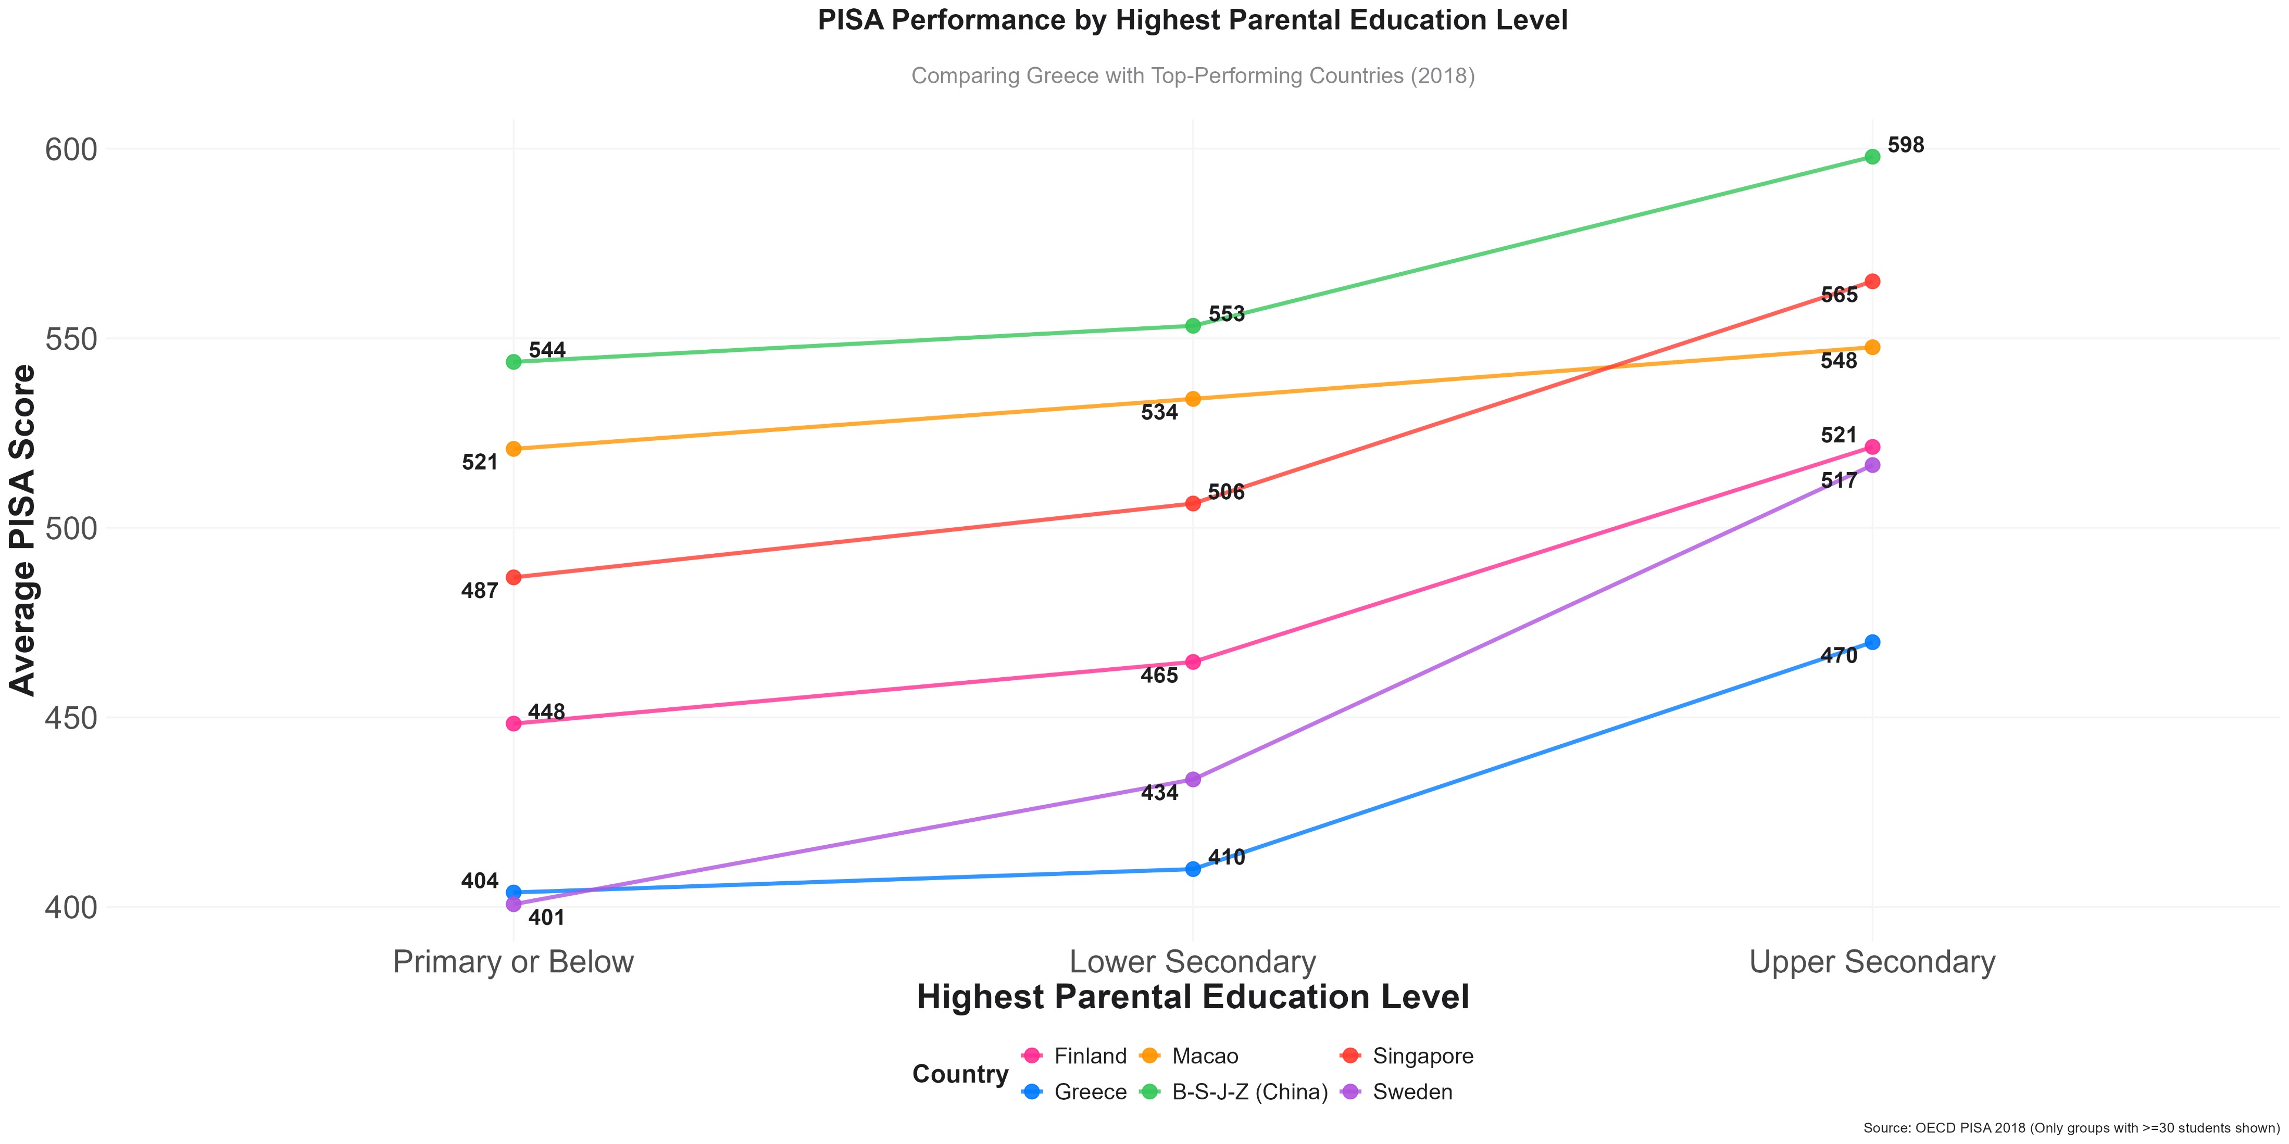
Socioeconomic Impact on Performance
Parental Education & Student Performance
Greece:
Greece shows a steady increase in student scores as parental education rises — from 404 (Primary or Below) to 470 (Upper Secondary).This represents a ~70-point gap, with lower baseline performance than peers.
Other Countries:
Singapore and China (B-S-J-Z) show the highest scores across all levels, but also a steep gradient — indicating strong impact of family background.
Macao Sweden and Finland exhibit less steep gains, reflecting more equitable systems where parental education has less impact on student outcomes.
Insights
In Greece, student success is closely tied to family education level.
Sources
OECD PISA 2018, World Bank Education Data
Greece in the Global Classroom: Insights from PISA 2018

Slide 15
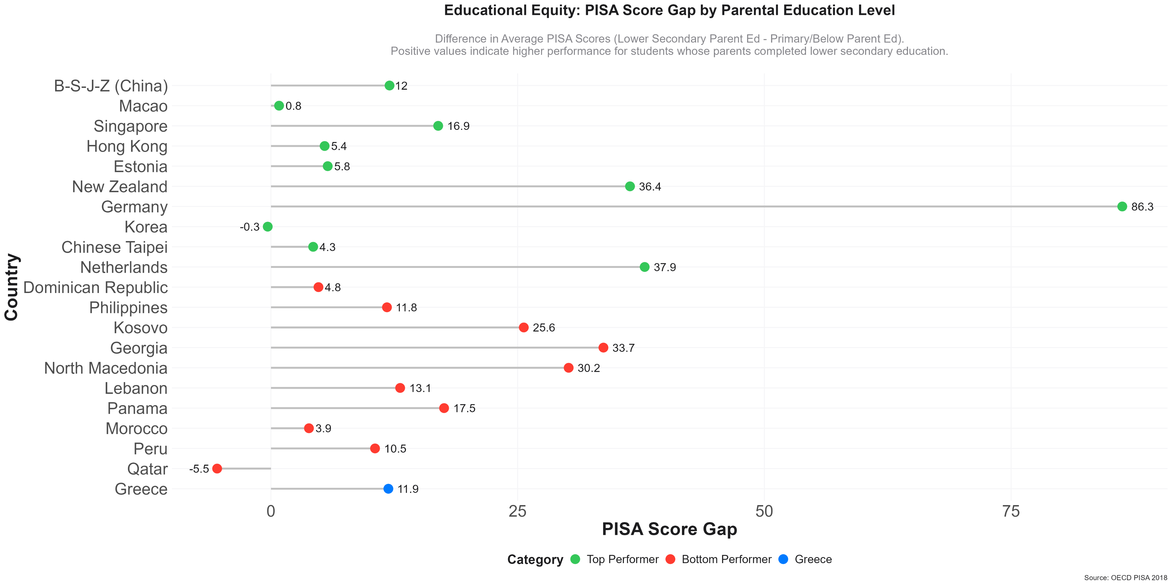
Educational Equity:
Gap Between Primary and Lower Secondary Parental Education
🔵 Greece:
- Greece shows a gap of 11.9 points, meaning students with lower-secondary educated parents perform moderately better than those with primary or less.
🟢 Top Performers:
- Countries like Singapore (16.9), China (12), and Korea (-0.3) show small or no gaps, suggesting greater equity at early education stages.
🔴 Bottom Performers:
- Bottom-performing countries like Georgia (33.7) and North Macedonia (30.2) display large gaps, highlighting strong socioeconomic dependence.
Insight:
- Greece’s early equity gap is moderate — it reflects some benefit from parental education, but equity could be improved with stronger foundational support.
Sources
OECD PISA 2018, World Bank Education Data
Greece in the Global Classroom: Insights from PISA 2018

Slide 16
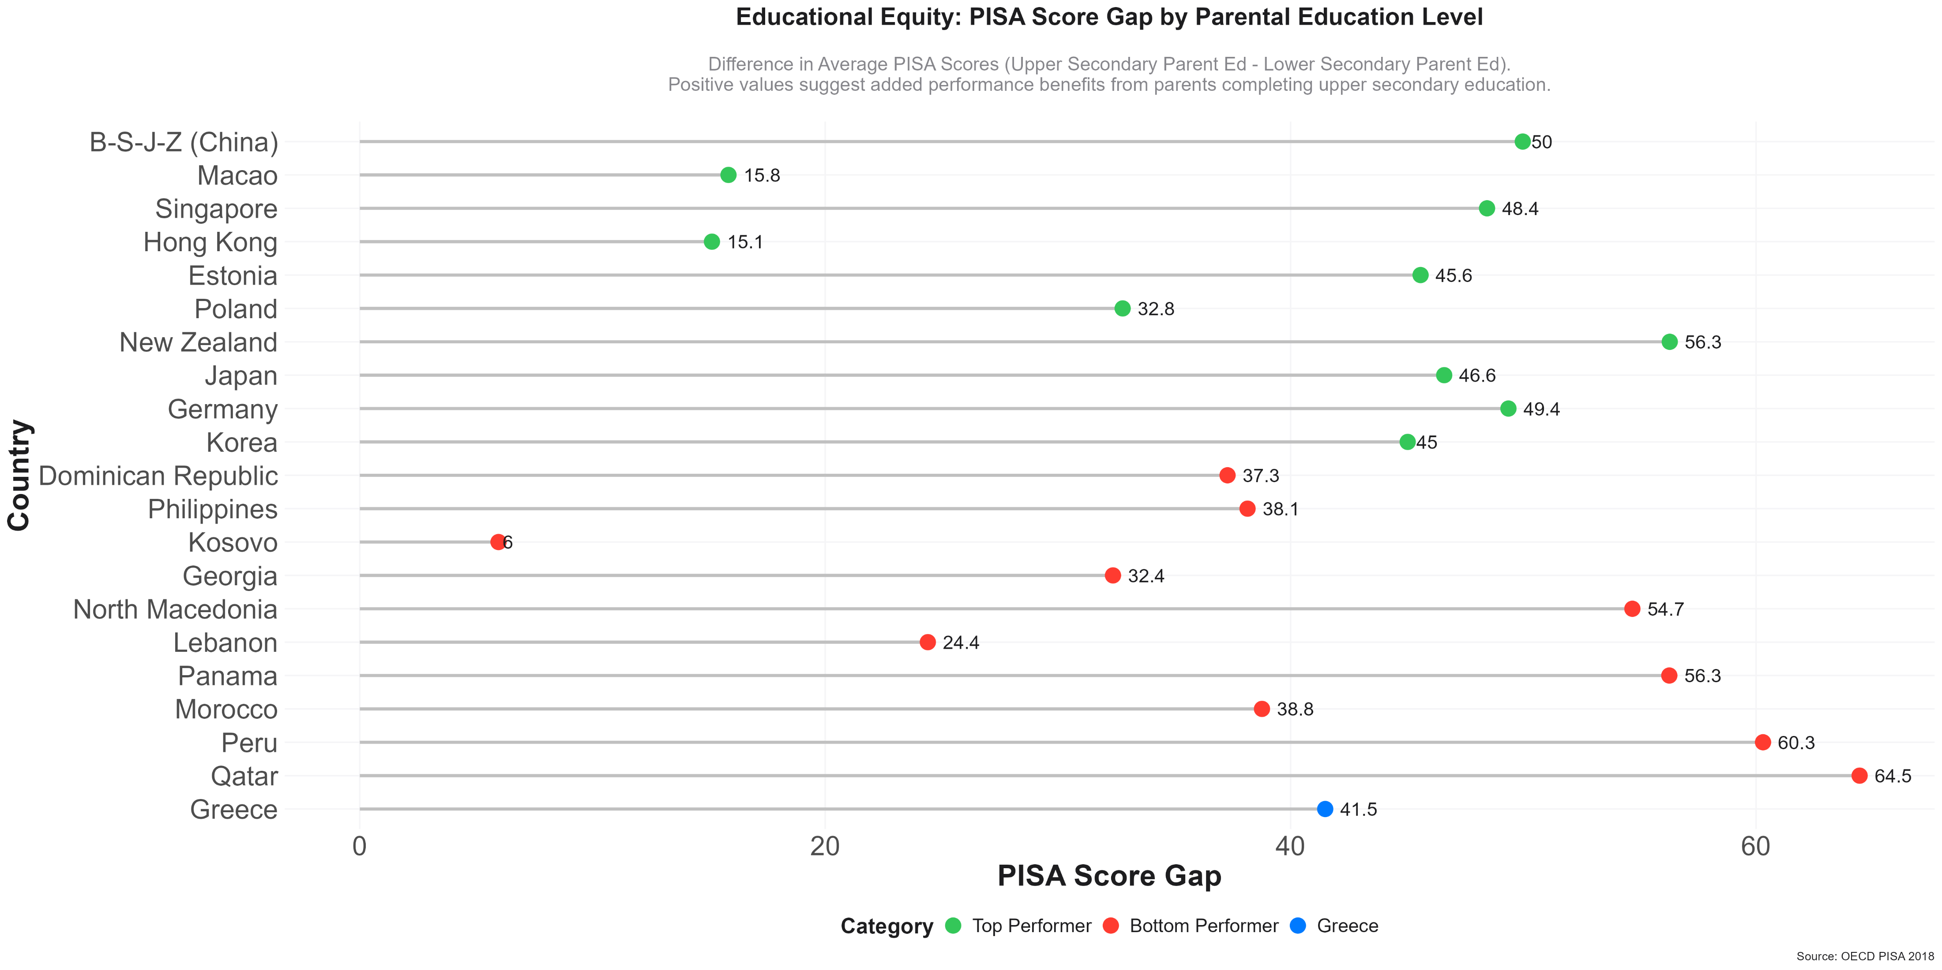
Educational Equity:
Gap Between Upper Secondary and Lower Secondary Parental Education
Greece:
🔵 Greece shows a gap of 41.5 points, meaning students benefit significantly when parents complete upper secondary education.
Other Countries:
🟢 New Zealand (56.3) and China (50.0) show strong but expected gains with upper parental education.
🔴 Countries like Peru (60.3) and Panama (56.3) exhibit high dependence on parental education, signaling systemic inequality.
Insight:
Greece’s uplift gap is large, suggesting parental education remains a key performance driver in secondary schooling outcomes.
Sources
OECD PISA 2018, World Bank Education Data
Greece in the Global Classroom: Insights from PISA 2018

Slide 17
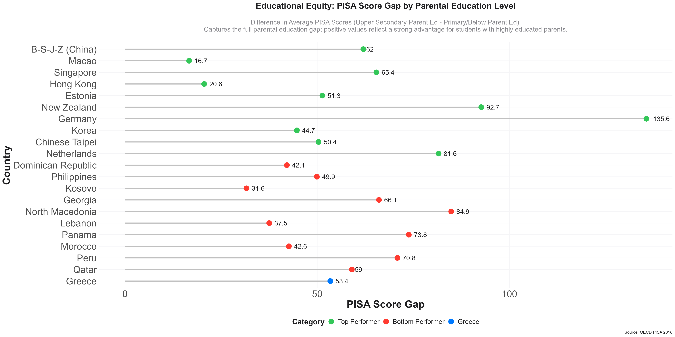
Educational Equity:
Gap Between Upper Secondary and Primary or Below Parental Education
Greece:
🔵 Greece shows a total gap of 53.4 points, meaning students with highly educated parents score substantially better.
Other Countries:
🟢 Germany (135.6) and New Zealand (92.7) show massive gaps, reflecting stratified systems.
🔴 Several lower-performing countries (e.g., Panama, Peru) also show large full gaps, highlighting persistent generational disadvantages.
Insights
Greece’s full gap is significant but not extreme — still, more targeted support is needed for students from low-Socioeconomic Status families.
Sources
OECD PISA 2018, World Bank Education Data
Greece in the Global Classroom: Insights from PISA 2018

Slide 18
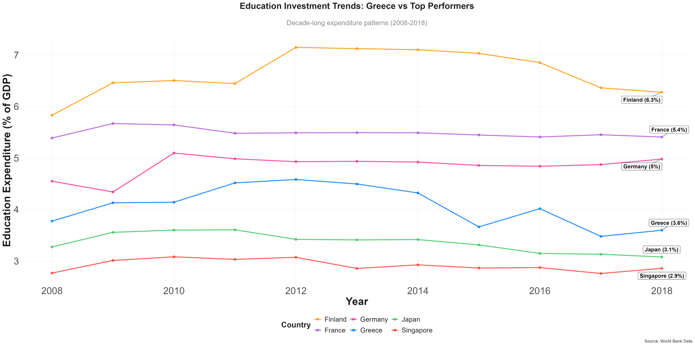
Education Investment Trends: Greece vs Top Performers
Investment in Education: 2008–2018 Trends
Greece
Started at 3.8% of GDP, peaked at 4.6% (2012), but dropped to 3.6% by 2018.Trend reflects economic constraints post-crisis.
Finland
- Consistently leads with 6–7% investment, finishing at 6.3% — highest among peers.
Other Nations
- France stable around 5.4%.
- Germany around 5.0%, with a slight upward trend.
- Japan and Singapore invest least (~3.1%–2.9%), yet perform strongly in PISA.
- Insights
Greece’s declining investment impacts education quality long-term.
High performance isn’t solely tied to high spending — but sustained investment like Finland’s shows clear benefits.
Effective use of resources is as critical as volume of spending.
Sources
OECD PISA 2018, World Bank Education Data
Greece in the Global Classroom: Insights from PISA 2018

Slide 19
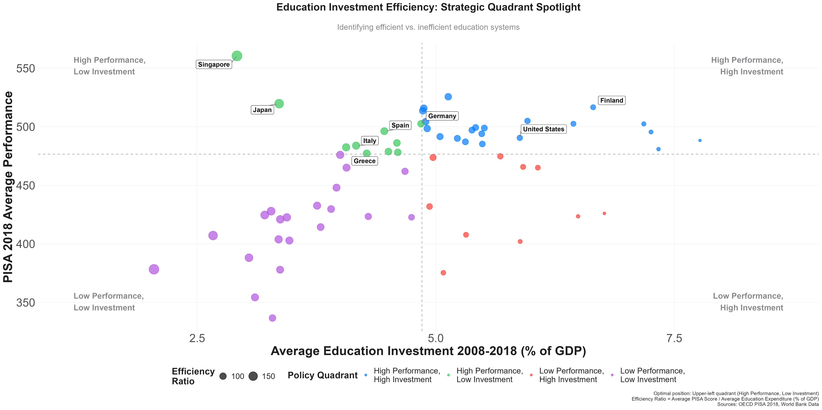
Socioeconomic Impact on Performance
Efficiency of Education Systems
Top Efficiency:
Singapore & Japan: High performance with low spending.
Best value-for-investment systems.
High Investment, High Performance:
Finland, Germany, U.S. perform well but at higher cost.
Greece:
Low performance despite moderate spending → low efficiency.
Positioned in low performance / low investment quadrant.
Insights
Greece must improve either investment efficiency or outcome returns to shift quadrant.
Sources
OECD PISA 2018, World Bank Education Data
Greece in the Global Classroom: Insights from PISA 2018

Slide 20
Tableau Dashboard
Greece in the Global Classroom: Insights from PISA 2018

Slide 21
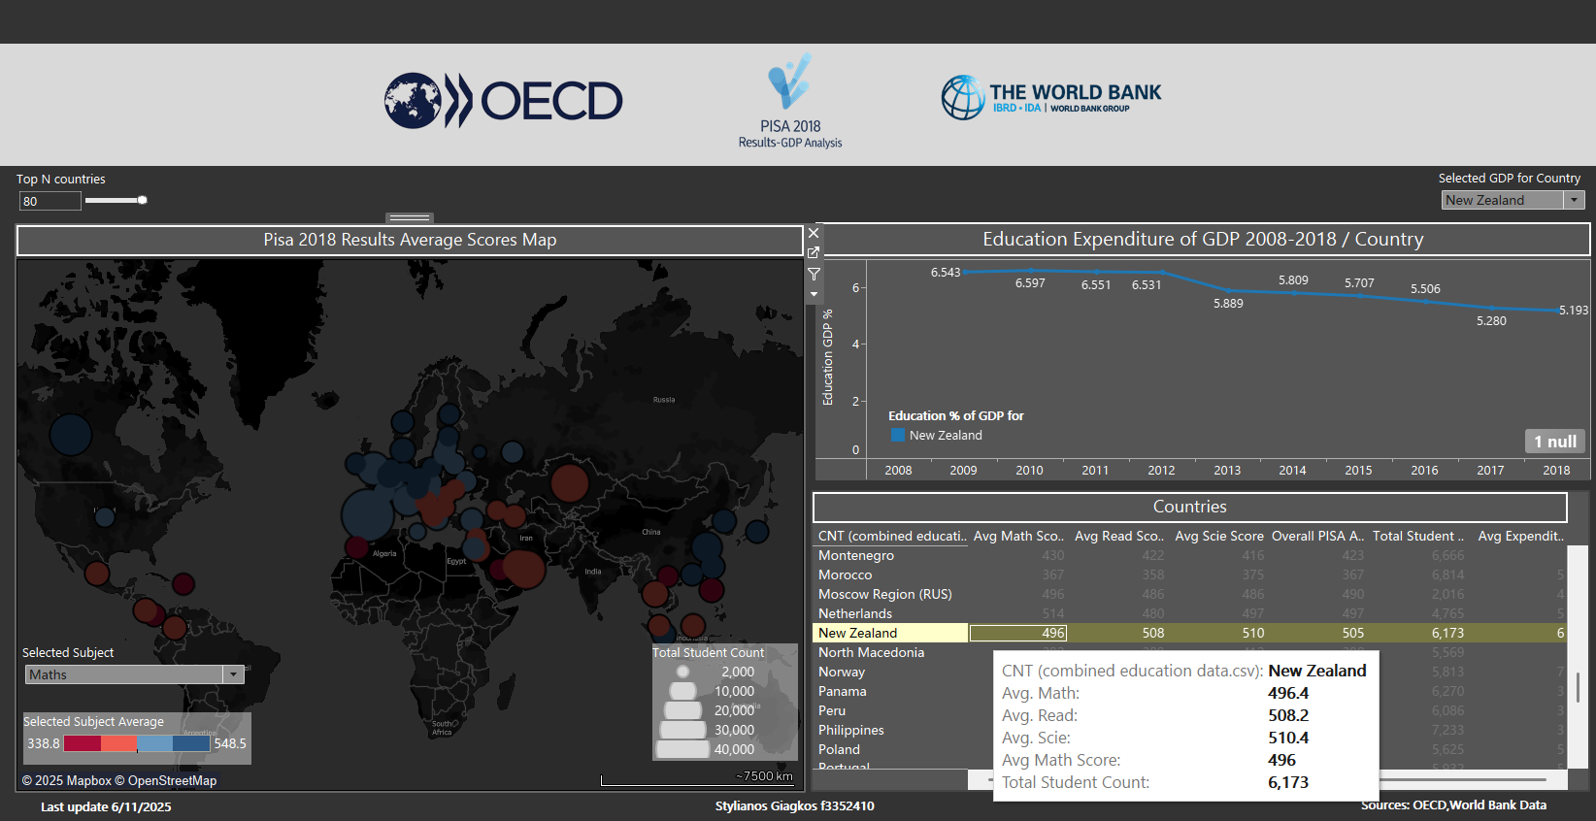
Dashboard
Click on Dashboard to Open Tableau File
Dashboard Purpose
To explore the relationship between educational performance (PISA 2018 scores) and national education expenditure (% of GDP) across countries, using dynamic visualizations.
Example Insight
New Zealand's education expenditure dropped from ~6.6% (2010) to ~5.2% (2018), yet it maintains high average scores (~500+), suggesting spending efficiency.
Dashboard Components
1. World Map of PISA Math Scores
Bubble Size: Total number of students per country.
Bubble Color: Average Math score
(red = low, blue = high).
Slider: Filter top N performing countries.
Subject Selector: Switch between Math, Reading, or Science.
2. Line Chart: Education Spending Over Time
Shows % of GDP spent on education (2008–2018) for selected country (e.g., New Zealand).
Reflects spending trends and potential correlation with performance.
3. Data Table: Country Metrics
Detailed metrics by country:
Average scores (Math, Reading, Science)
Overall PISA score
Total student count
Average GDP education expenditure
Sources
OECD PISA 2018, World Bank Education Data Dashboard by:
Stylianos Giagkos
Greece in the Global Classroom: Insights from PISA 2018

Slide 22
Conclusions and
Policy Recommendations
Greece in the Global Classroom: Insights from PISA 2018

Slide 23




Summary of Findings
Performance:
Greece performs below the OECD median in all subjects.
Gender gaps exist but are aligned with international trends.
Equity & Socioeconomic Influence:
Parental education strongly impacts student performance.
Greece shows moderate-to-large equity gaps, especially in upper education transitions.
Investment vs Outcome:
Education funding has declined, and returns are relatively low.
Greece sits in the low efficiency quadrant, unlike top performers.
Global Standing
Greece is not among the lowest, but trails behind high-achieving and equitable systems.
Room for reform and smarter investment is clear.
Greece in the Global Classroom: Insights from PISA 2018

Slide 24




Toward a More Equitable and Effective Education System
1. Strengthen Early Support
Expand early childhood education and literacy programs for low-SES families.
2. Target Socioeconomic Gaps
- Introduce performance-based funding to schools in disadvantaged areas.
- Provide mentoring, tutoring, and enrichment for underperforming groups.
3. Promote Equity in Secondary & Tertiary Transitions
Reduce dropout rates and support pathways to upper secondary and vocational education.
Room for reform and smarter investment is clear.
4. Optimize Education Investment
- Increase investment in education gradually toward OECD average.
- Ensure funds target classroom-level quality, not just administrative expansion.
5. Leverage Data for Policy
Use PISA insights and school-level metrics to monitor impact, equity, and effectiveness.
Greece in the Global Classroom: Insights from PISA 2018

Slide 25
Thank You!

